Slide 1

Hitaya DApp
Base234

Slide 2
TIMELINE
1
Introduction
2
Primary Goals Of The Application
3
Technology Used
4
Future Scope

Slide 3
INTRODUCTION
Hitaya DApp is derived from a Sanskrit word which means Welfare.​
Hitaya DApp primary focus is to enable users belonging to an organization to transfer tokens or (HAT Tokens) which will be widely accepted in the organization as a form of coupons/currency in organization canteen, gyms or malls, or users can transfer this tokens among its peers or swap it with other tokens or currency, save contacts in blockchain, and view income/expenditure in a dashboard.

Slide 4
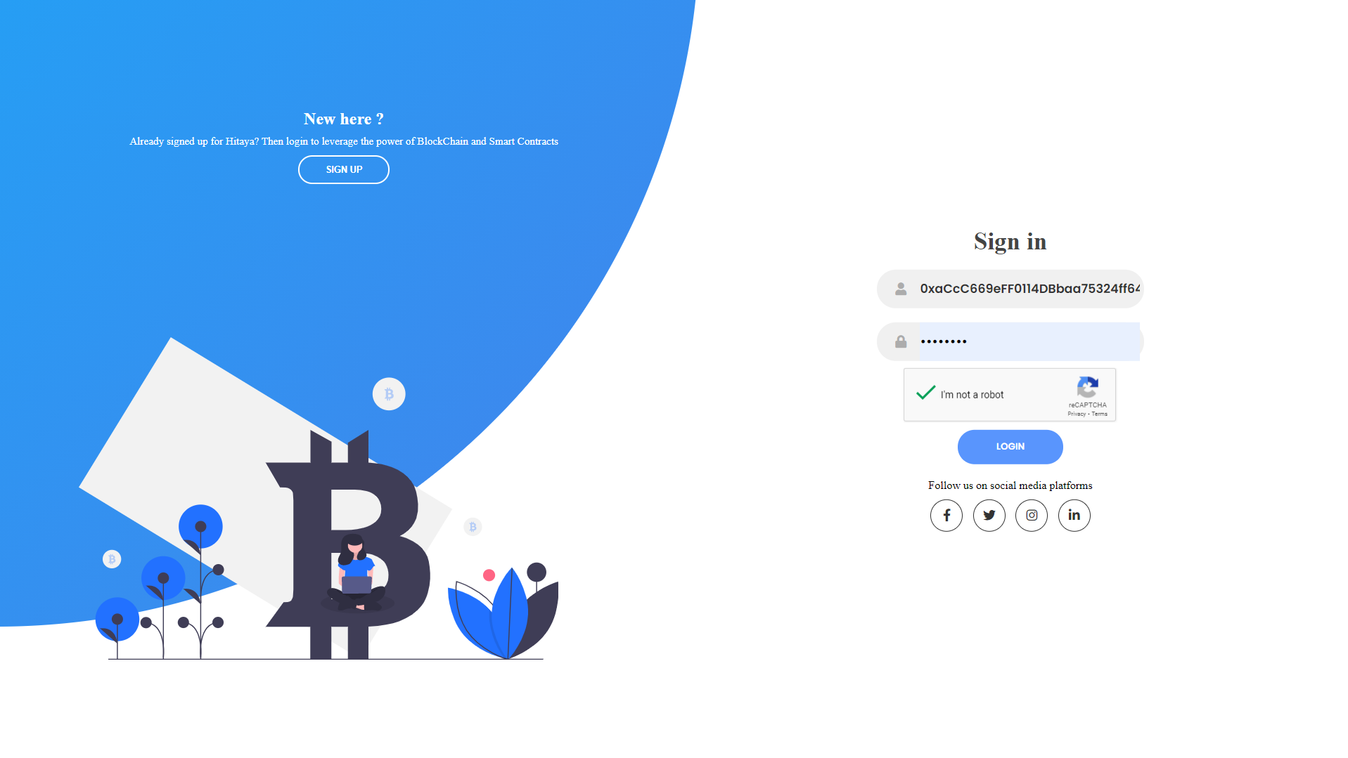

Slide 5
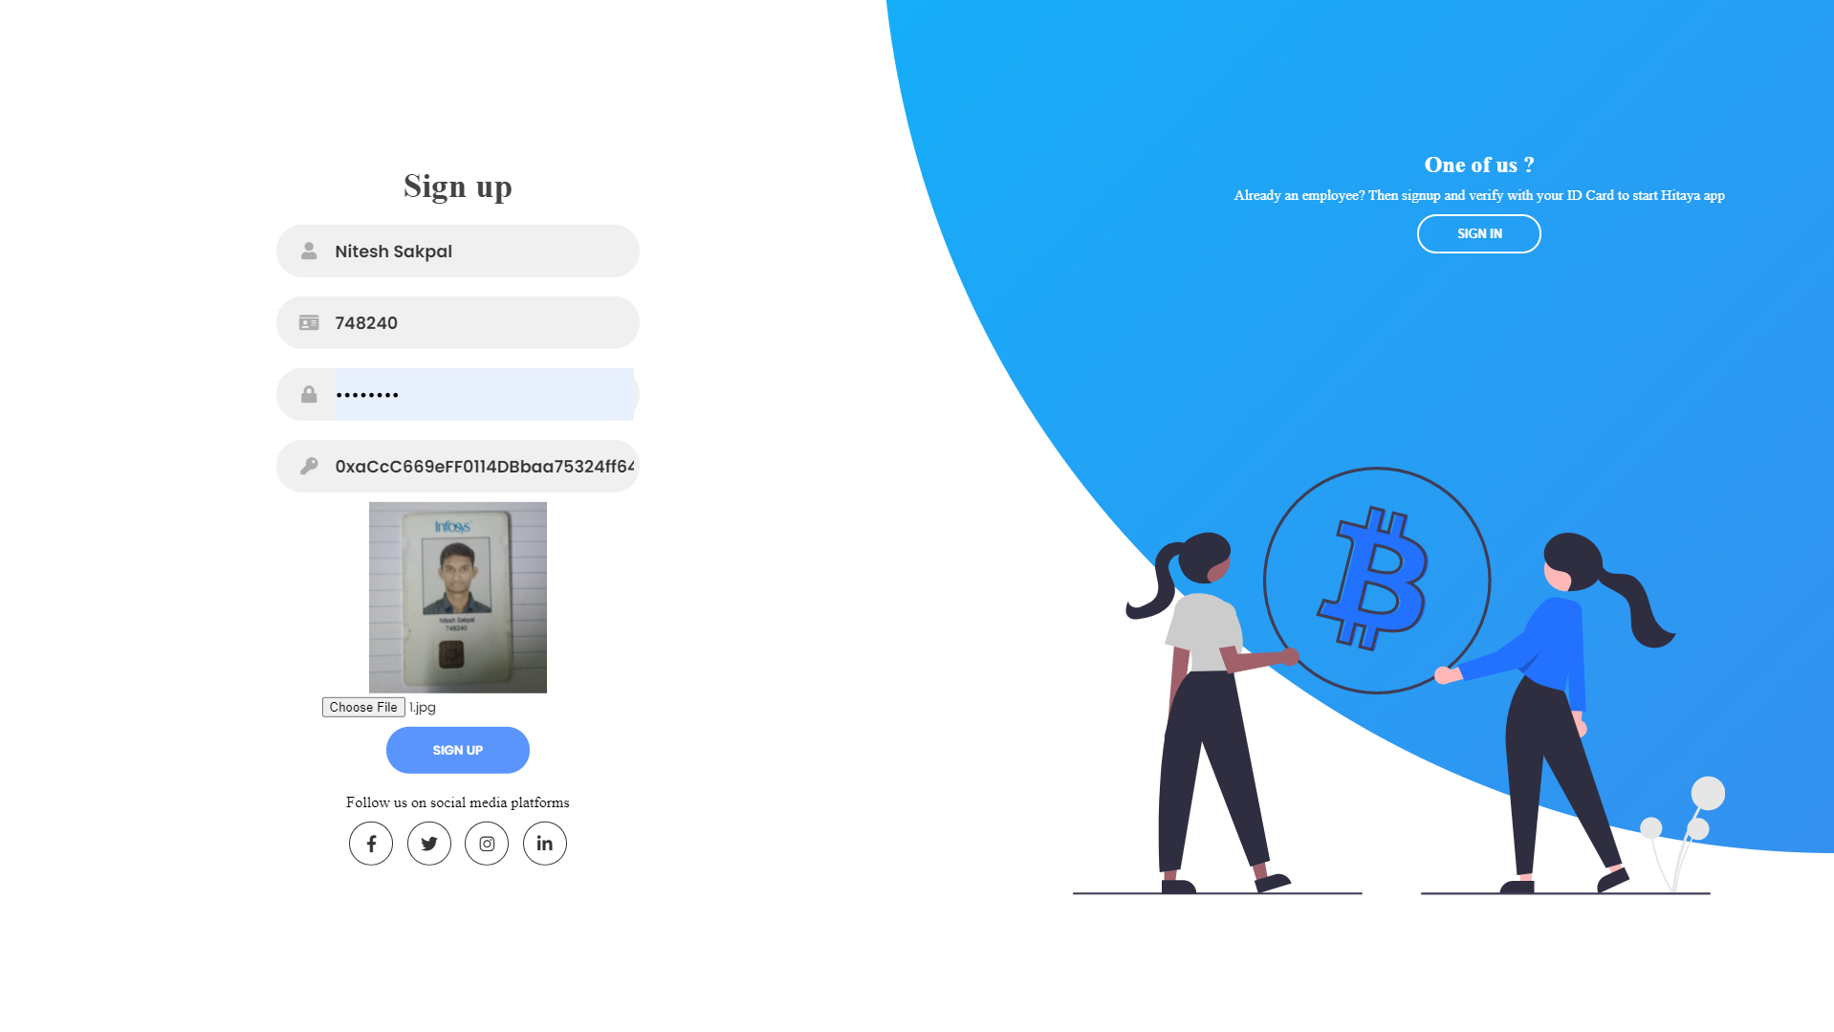

Slide 6
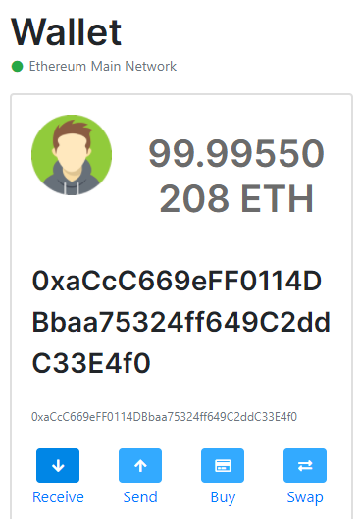

wallet

Slide 7
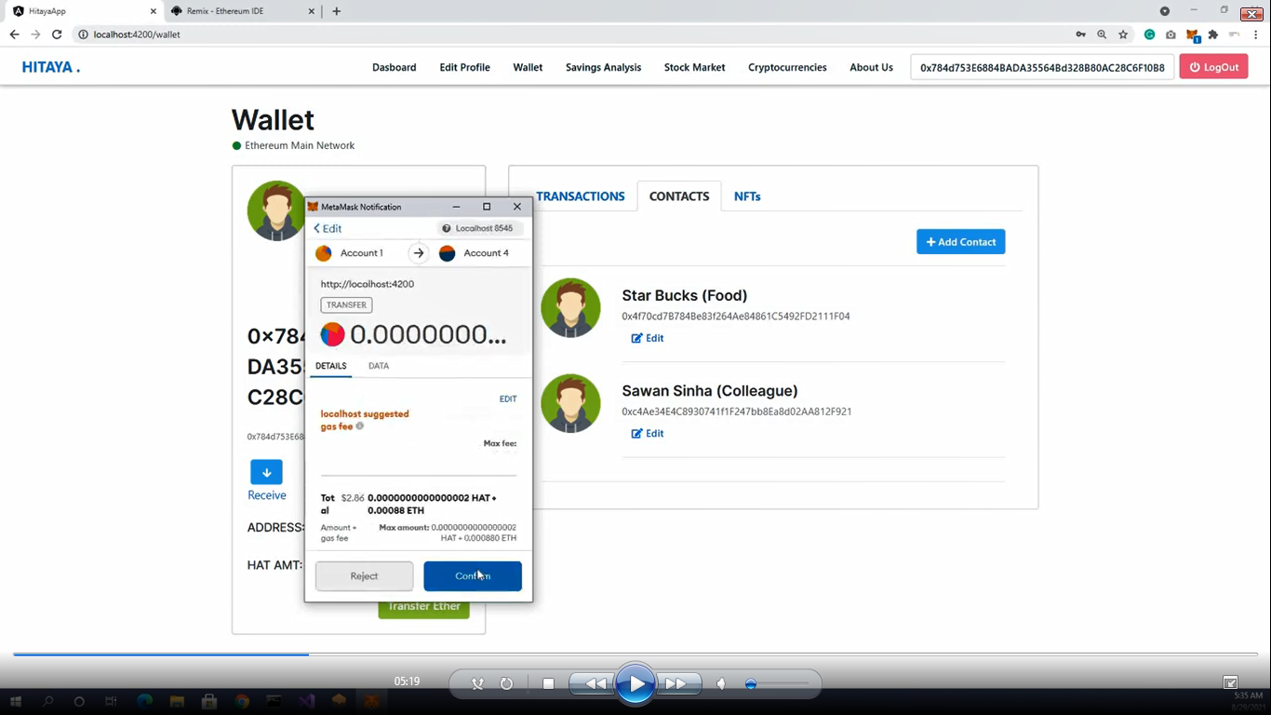

Slide 8
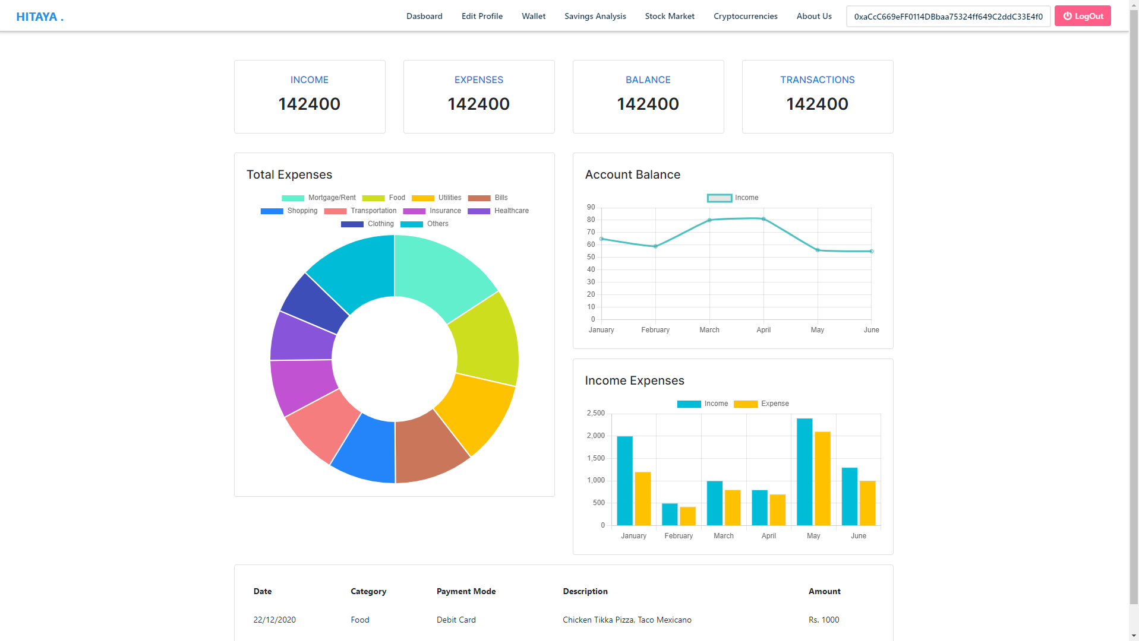

Slide 9
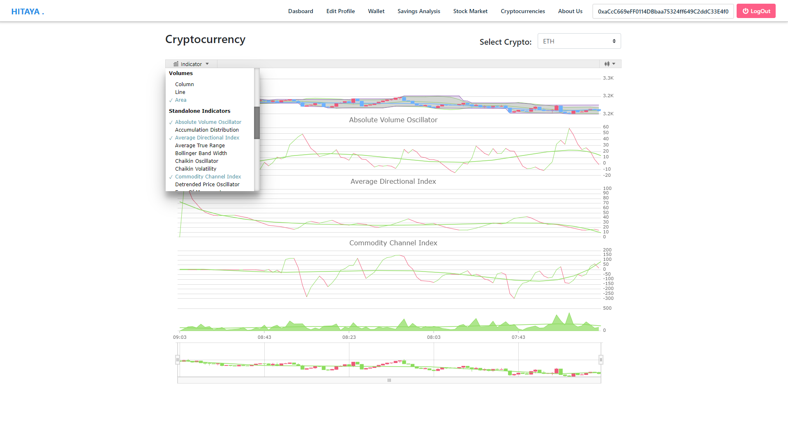

Slide 10
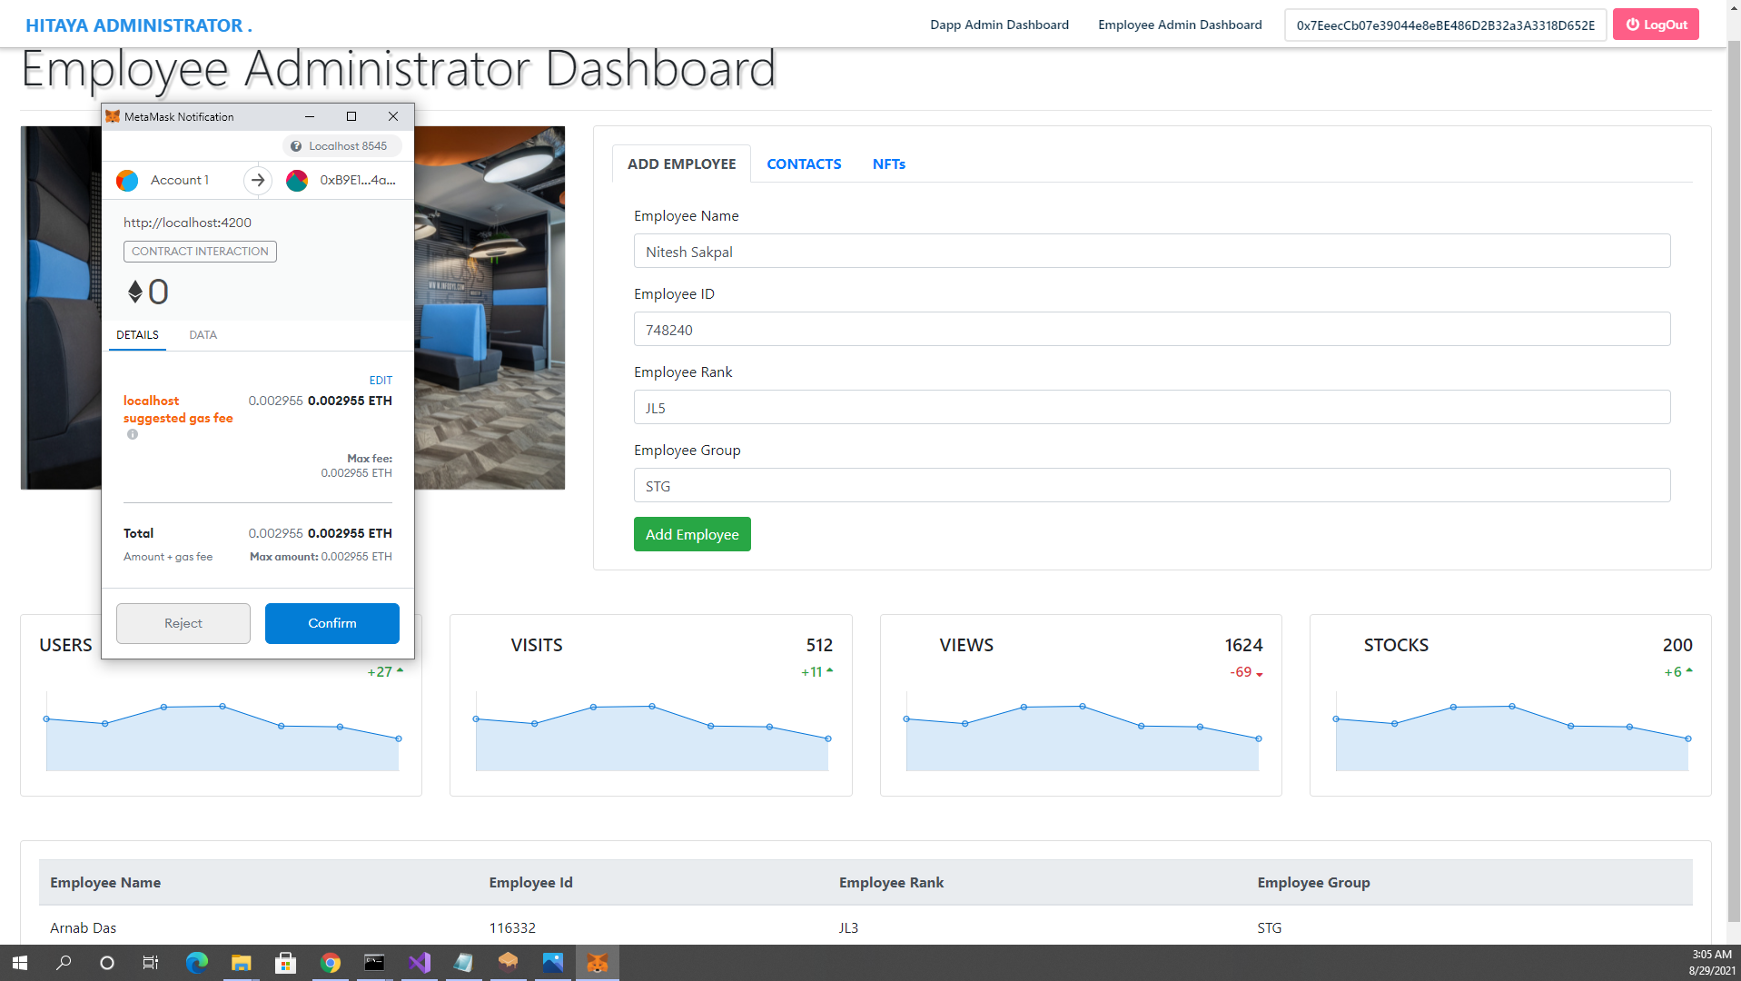

Slide 11
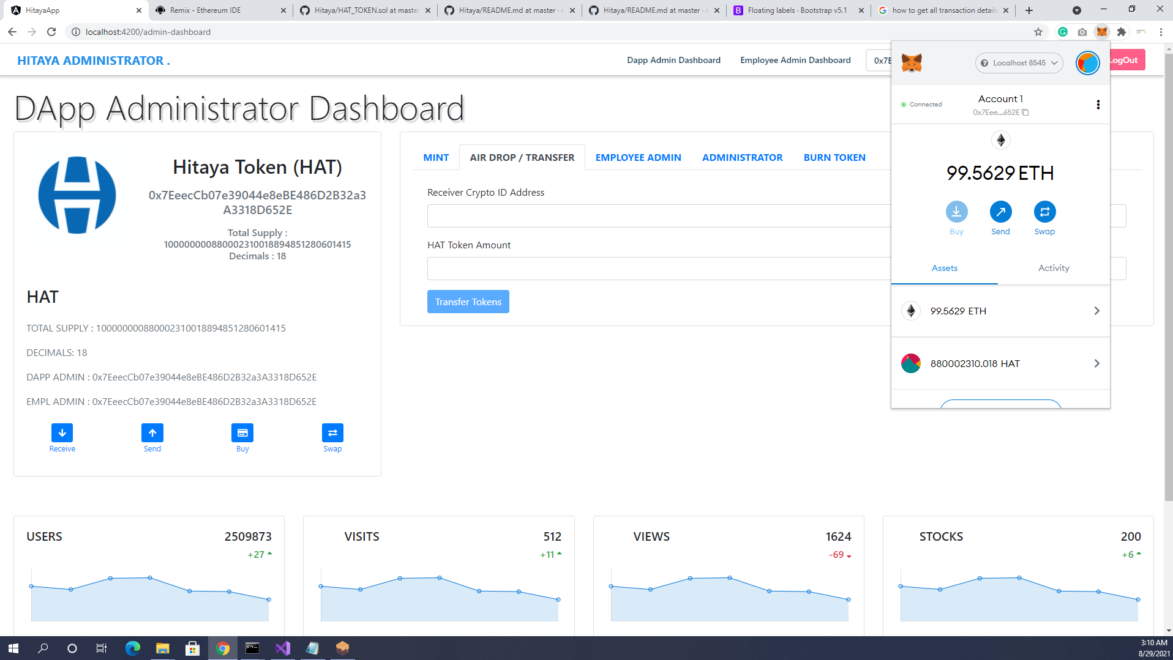

Slide 12

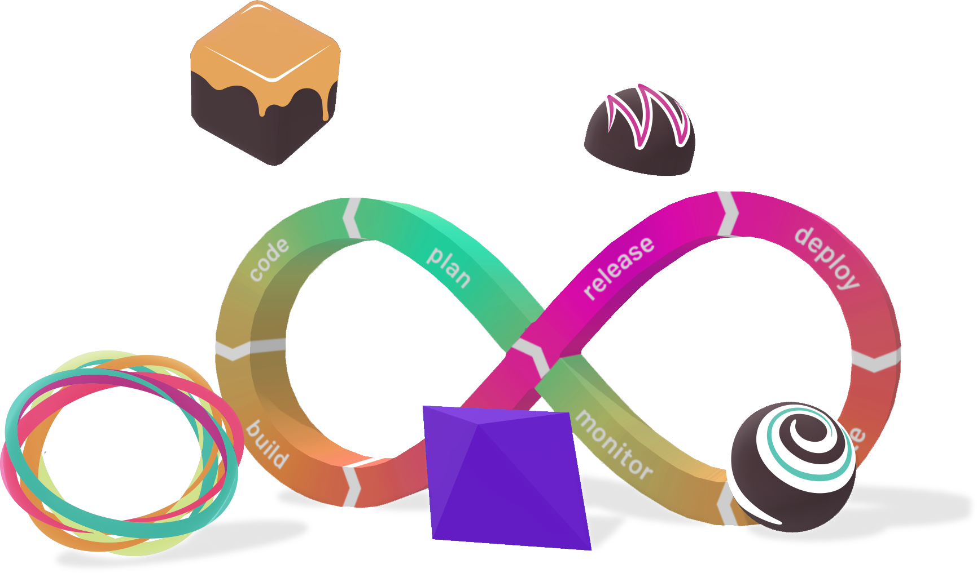
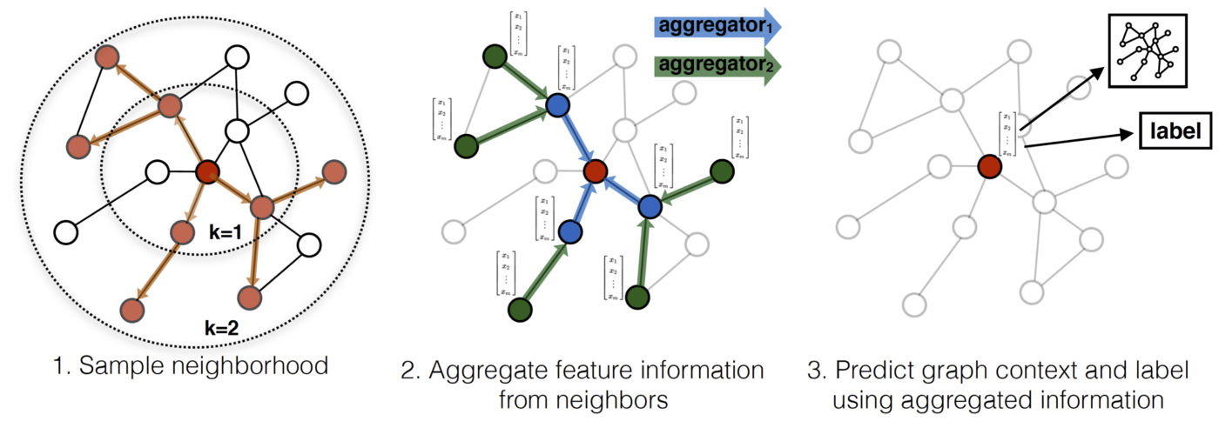
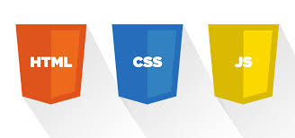
TECHNOLOGIES USED IN THE APPLICATION
FRONT END
ANGULAR
HTML
CSS
JAVASCRIPT
OCR USING ML
BACKEND
Web3.js
TRUFFLE
GANACHE
SOLIDITY
ETHEREUM
PYTHON
FAST API
TENSORFLOW
(Graph Neural Network)

Slide 13
FUTURE SCOPE .​

Slide 14
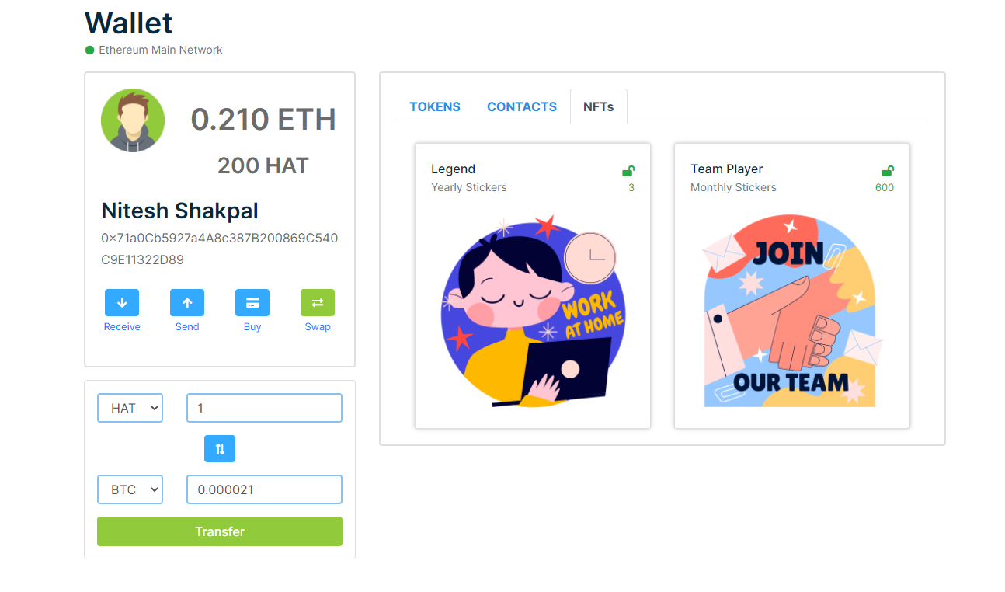
IMPLEMENTING NFTs
NFTs
Employee Admin can transfer NFTs to employees based on Weekly / Monthly / Yearly performance.​
Users can sell / auction this Tokens on HAT exchange with other users.

Slide 15

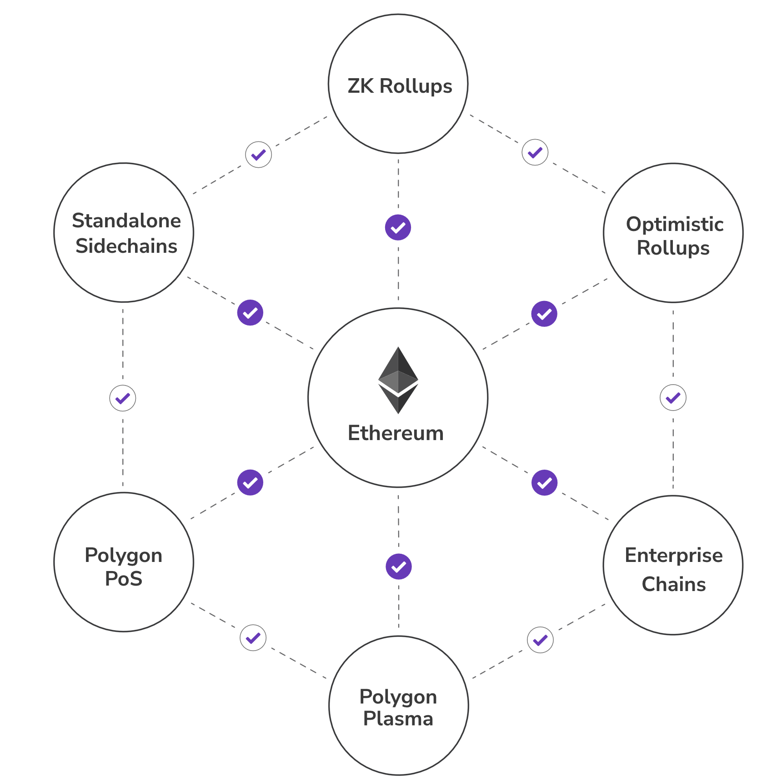
TRANSFER THE APPLICATION TO POLYGON
Polygon
Use of Polygon application tools and technology and use of MATIC Tokens to reduce gas fees and increase transaction speeds.

Slide 16
SUMMARY
Thanks for conducting this hackathon, It was a wonderful learning experience in the field of blockchain.

